Slide 1
Formative Research
Rapid Appraisal
Participatory Action Research
Robert Kelly, Ph.D.
Prepared by AED

Slide 2
Chiang Rai & Trat
Rapid Appraisal
Prepared by AED

Slide 3
Research parameters
Size, approximate population and dispersion
Province sub-divisions
Major target groups: migrant workers, hill tribes, transport
workers, traders and market vendors
Major stable and mobile target groups and their sizes
Interactions between migrants, hill tribes and others
Markets, truck stops and schools
Health, education, social and NGO services
Social cultures of migrants, hill tribes and others
Potential communication interventions
Communication intervention resources needed

Slide 4
Chiang Rai – Trat
Chiang Rai
Northern Thailand
Borders Burma and Laos/Chiang Mai, Lampang, Pha Yao Provinces
Major international corridor
Minority – hill tribes, Burmese
Malaria not important
Dengue important
Trat
Eastern Thailand
Borders Cambodia/Chanthaburi Province
Minor international corridor
Minority – Cambodian
Malaria important
Dengue important

Slide 5
Chiang Rai Province
Size: 11,678 km.²
Population: 1,259,437
Hill tribe population: 220,000
(registered only included in above number)
Burmese, Laotian population: 90,000
Thais in plains
Hill tribes in mountains and plains
More rural than urban

Slide 6
Trat Province
Size: 2,000 km.²
Population: 220,000
Non-Thai population: 10,000
majority Cambodian, followed by Burmese and Laotians
Populations integrated
More rural than urban

Slide 7
Districts
Chiang Rai
Muang Chiang Rai (capital district), Mae Fa Luang,
Mae Chan, Wiang Chiang Rung, Wiang Chai, Thoeng,
Pa Daet, Phan, Mae Lao, Mae Suai
Trat
Muang Trat (capital district), Khlong Yai, Khao
Saming, Bo Rai, Laem Ngob, Koh Kut, and Koh Chang

Slide 8
Methodology 1
Desk research
Chiang Rai Province
9 In-depth interviews (IDI)
Vice-Governor of Chiang Rai Province
Director of the Department of Social and Preventive Medicine at provincial hospital
Director of the Chiang Rai Special Education System
Health volunteer for malaria and dengue
District hospital director
Border customs’ official
Border health official
Border immigration official
Garment factory industrial operator

Slide 9
Methodology 2
Chiang Rai Province
3 Focus group discussions (FGD)
Transport workers
Laotian migrants
General population

Slide 10
Methodology 3
Trat Province
6 In-depth interviews (IDI)
1. Malaria Services’ director
2: a school teacher in Trat
3. a vendor/village chief in Hadlek at Thai-Cambodia border
4: a restaurant owner in Khlong Yai
5: a Malaria Services volunteer in Khlong Yai.
6: a fruit juice businessman and his sister, a lab technician
for the Malaria Service in Khlong Yai.

Slide 11
Methodology 4
Trat Province
3 focus group interviews (FGD)
1: general population
2: shrimp farm workers
3: Cambodian lumber yard workers

Slide 12
Language situation
Chiang Rai
Majority languages: Standard Thai and northern Thai
Minority languages: hill tribe languages, Burmese, Lao
Laotians speak language close to Thai
Many hill tribe people bilingual in Thai
Few Burmese speak Thai
Trat
Majority language: Thai
Minority languages: mostly Khmer, some Burmese, Lao
Cambodians speak language (Khmer) unlike Thai
Laotians speak language like Thai
Few Burmese speak Thai

Slide 13
Target groups
Malaria Chiang Rai
Hill tribes
People from other countries:
Burmese, Laotians
Forest workers
Dengue Chiang Rai
Urban lowland population,
now also in the countryside
Malaria Trat
Forest workers/foragers
Cambodian border crossers
Migrants without papers
Soldiers posted to forest areas
Dengue Trat
Urban lowland population,
now also in the countryside

Slide 14
Thais/non-Thais
Thais
Non-Thais
Hill tribes
Foreigners: Cambodians, Burmese, Laotians
Shared vulnerability: marginal work, work in areas
exposed to mosquitoes, travel/visits across borders
Many “migrant” populations have been in Thailand for years

Slide 15
Transport corridor, Chiang Rai
Links Bangkok via Chiang Rai via Bokeo (Laos) via Luang Namtha
(Laos) with Mengla County (China)
Crosses Mekong River at Chiang Khong to Laos
3,000 vehicles (mostly trucks) cross at Chiang Khong every month
18,000-24,000 persons (mostly tourists) cross at Chiang Khong
every month
Conduit for commerce to/from Bangkok/China
Bridge resulting in increased traffic being built to replace ferry
Laotians come to shop, for medical treatment

Slide 16
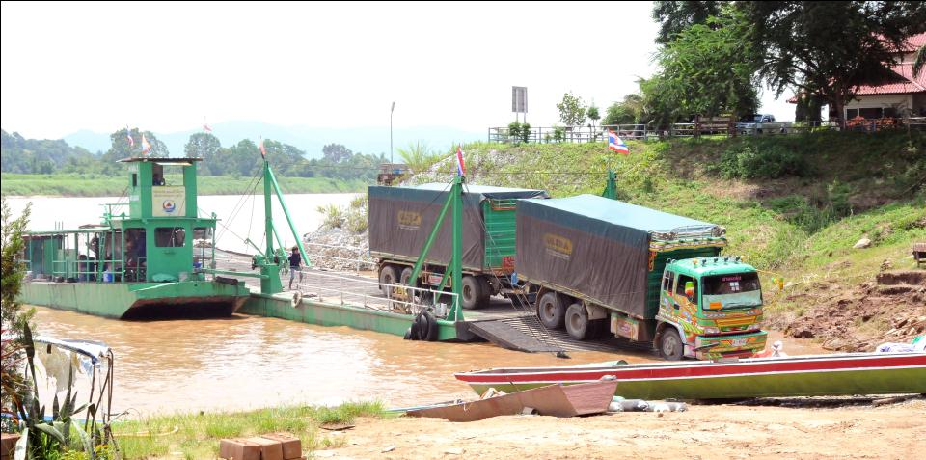
Chiang Khong vehicle ferry

Slide 17
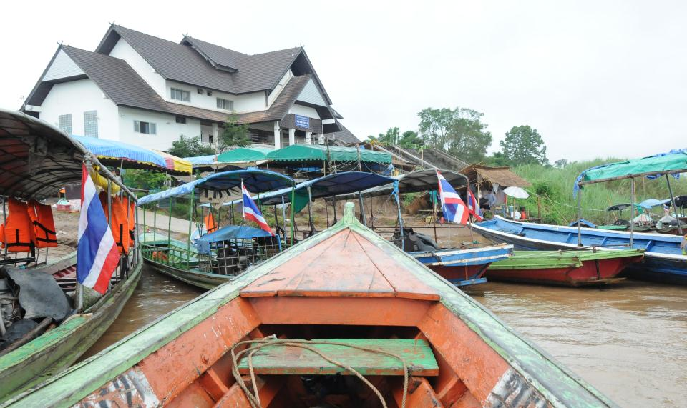
Passenger boat landing in Laos

Slide 18
Transport corridor, Trat
Links Trat to Koh Kong (Cambodia) through Hadlek
(Thailand)
600 vehicles (mostly trucks) cross at Hadlek every month
6,000 persons (Cambodian, Thai) cross at Hadlek every month
Corridor for commerce to/from Trat and Koh Kong (Cambodia)
Large fishing/lumber port at Khlong Yai with many
Cambodians

Slide 19
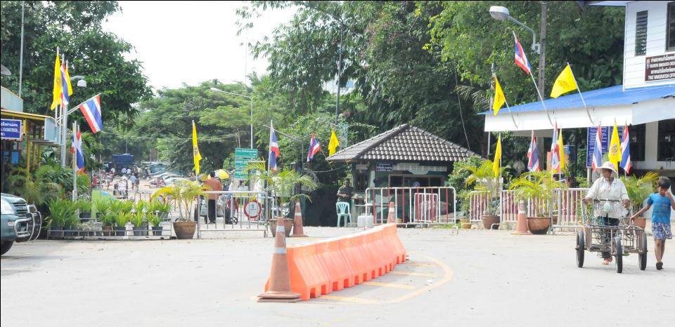
Cambodia-Thailand border at Hadlek

Slide 20
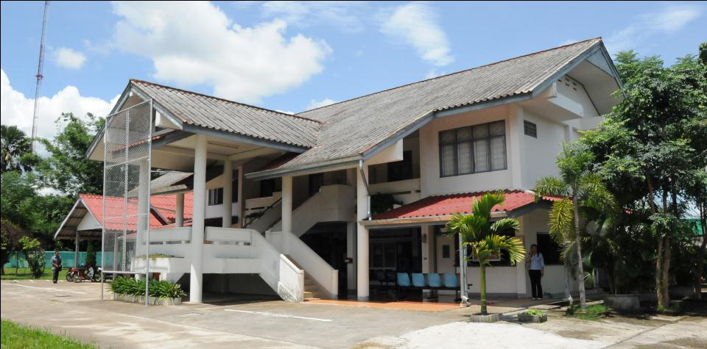
Chiang Rai: 1 central hospital, 16 district hospitals, 211 health centers Trat: 9 hospitals, (2 public, 1 private in Muang Trat), 1 in other 6 districts, 60-70 health centers

Slide 21
Risk groups
Malaria
Forest workers
Foragers
Migrant workers
Hill tribes
Border soldiers
Dengue
Urban people, some rural people now too

Slide 22
Disease risks
Occupation: forest workers prone to contract malaria
Border-crossing: risk of contracting/carrying disease from another country
Living style: fewer prevention measures used
Lack of health cards: less use of health services
Fear of prosecution: avoidance of health services
Distance from health services: longer time for seeking treatment

Slide 23
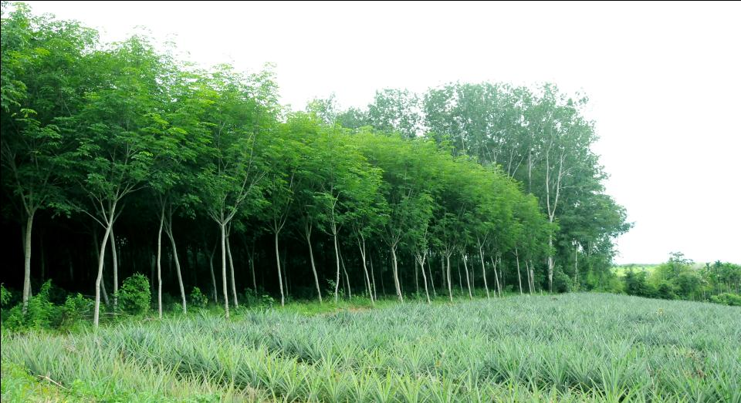
Rubber plantation, pineapples near Trat

Slide 24
Most people believe that malaria and dengue are transmitted by …
Anopheles
Aedes

Slide 25
Improving malaria prevention
Spray outside and inside to eliminate mosquitoes
Protect against mosquitoes with bed nets, lotions, creams, fans, screen doors, clothing
Improve communication with non-Thais through translation
Increase and improve disease-related teaching materials
Improve health education curriculum, including outreach methodology and prevention techniques
Use village health volunteers or malaria centre agents for prevention
Improve surveillance by including teachers
Make sure that visitors from high risk areas are tested and treated

Slide 26
Improving malaria/dengue diagnosis
Encourage people to go to a health facility as soon as possible after symptoms appear
Develop rapid response system for diagnosis and treatment
Test people from high-risk areas
Continue use of screening in outbreak areas
Provide teachers with training on how to recognize symptoms

Slide 27
Improving treatment
Increase surveillance during outbreaks
Encourage those diagnosed with disease to complete the full course of medication
Improve health service transportation in remote areas
Increase health volunteer communication activities
Minimize the time between symptom appearance, testing/diagnosis and treatment

Slide 28
Trusted persons
Health volunteers
Malaria center agents
Doctors
Parents (younger respondents)
Community members

Slide 29
Trusted community resources
Village meetings
Loudspeakers
Mobile vans (Trat)
Local FM radio

Slide 30
Attitudes or behaviors 1
Get diagnosed
Refers to mechanisms for encouraging diagnosis as soon as possible. The idea is that the sooner a case is identified, the quicker the treatment and the lower the likelihood of further spread.
Get treated
Refers to mechanisms to assure treatment as soon as possible after diagnosis.
Take the medicine
Refers to the development of incentives for diagnosed patients to complete the full course of medication prescribed. Less than optimal compliance could result in increase of drug-resistant varieties of a disease.

Slide 31
Attitudes or behaviors 2
Assure care for all
Refers to ways the health care delivery system could be re-structured to insure that everyone, regardless of citizenship status, be provided with appropriate prevention, diagnostic and treatment.
Sleep under a bed net
Refers to messages encouraging universal bed net use. (Lowering transmission rates)
Put the sand in the water
Refers to the use of temephos (Abate) to kill dengue mosquito larvae in still water.
.

Slide 32
Attitudes or behaviors 3
Clean up water sources
Refers to messages encouraging people to clean still water sources so that dengue mosquito larvae do not increase and multiply.
Mosquitos cause malaria/dengue
Refers to messages and information which would reinforce the point that it is mosquitos which cause malaria and dengue. (Not dirty water or the effects of evil spirits)
This is malaria/dengue
Refers to materials explaining symptoms of malaria/dengue and what to do.

Slide 33
Key Points
Focus on high risk
Definitions needed for “migrant” and “mobile”
Different diseases occupy different social, geographical, temporal and behavioral spaces
The language spoken by a group plays a major role in communication
Transportation and population movement corridors are key components in disease transmission.

Slide 34
PAR Studies

Slide 35
PAR Mukdahan

Slide 36
Participatory Action Research (PAR)
Qualitative research that allows community members to participate, learn from each other, and address issues that threaten their livelihoods, health, and life.
Requires stakeholders to work jointly with community members
Uses inexpensive and culturally relevant tools
Rapid collection of data
Allows community members to exchange ideas and discuss courses of actions
Information is only considered valid if the same results are found using several PAR tools

Slide 37
Objectives
To gain a better understanding of the community members’ knowledge, attitudes, and practices regarding acute febrile illnesses (AFI), including influenza, malaria and dengue, and its effects
To offer an opportunity for the community to exchange ideas about health issues in their communities, and determine feasible interventions to reduce disease entry
To inform the development/adaptation of behavior change communication materials for target groups

Slide 38
Process
Discuss with central and provincial health authorities
Select sites
Develop questionnaire
Touch base with district health office
Make arrangements with community leaders
Organize PAR master training
Organize PAR training for public health officers and community leaders, community health volunteers
Prepare tools for data collection
Conduct PAR in the community
Analyze data and summarize report
Share findings
Develop communication plan

Slide 39
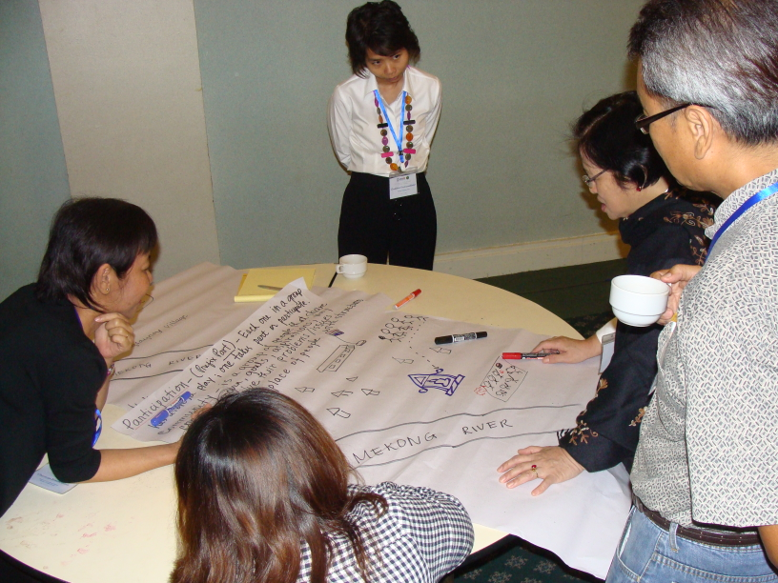
PAR Master Training
Lead facilitators were orientated and trained on PAR methodology and techniques by AED PAR expert during May 12 – 13, 2010 in Mukdahan

Slide 40
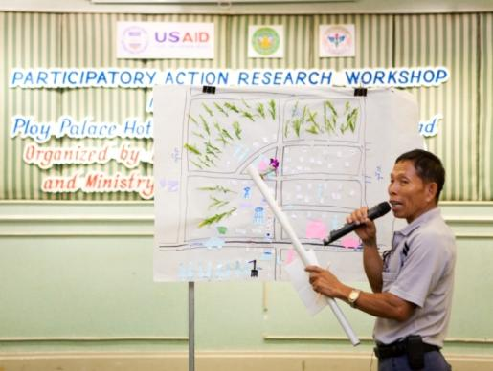
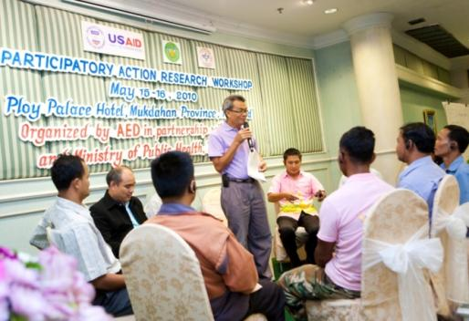
PAR Training for Local Health Officers & Community Representatives
Public health officers from Mukdahan and Savannakhet provinces,
Local authorities and village health volunteers (VHVs) from Kam Pa Lai community
Trained on PAR methodology during May 15 – 16, 2010 in Mukdahan

Slide 41
PAR Activity in Community
Four (4) villages (Moo 1, 10, 12 and 16), Kam Pa Lai Sub-district
Four (4) PAR sub-teams were formed. Each sub-team includes:
Lead facilitator
Observer (AED international staff)
Note taker (health officer)
Observer (health officer)
Note taker (villager)
Observer (villager)
Village chief/ village chief assistant

Slide 42
PAR
Kam Pa Lai Village, Muang District, Mukdahan
(18-20 May, 2010)

Slide 43
Themes/ Topics | PAR Tools
Village overview e.g. village activities, daily activities, and general village information | Focus Group Discussions (FGDs) Observation Mapping Transect Walk Daily schedule Seasonal calendar
Cross-border issues | FGDs Pie Diagram
Issue/ problem identification | Bean Quantification
Cause and recognition of symptoms | Lists of symptoms Classification of severity of each symptom (mild/ severe)
Treatment/ Home care | Flow chart and/ or Chappati Pie Gender role Individual interviews (IDIs)
Communication Channels | Pairwise ranking
Practices to Prevention | FGDs List of practices to prevention
Impact of diseases/ issues toward individuals and community | FGDs Individual interviews (IDIs) List of impact
Conclusion and “next steps” for ACTION | Causal flow diagram Force Field Analysis

Slide 44
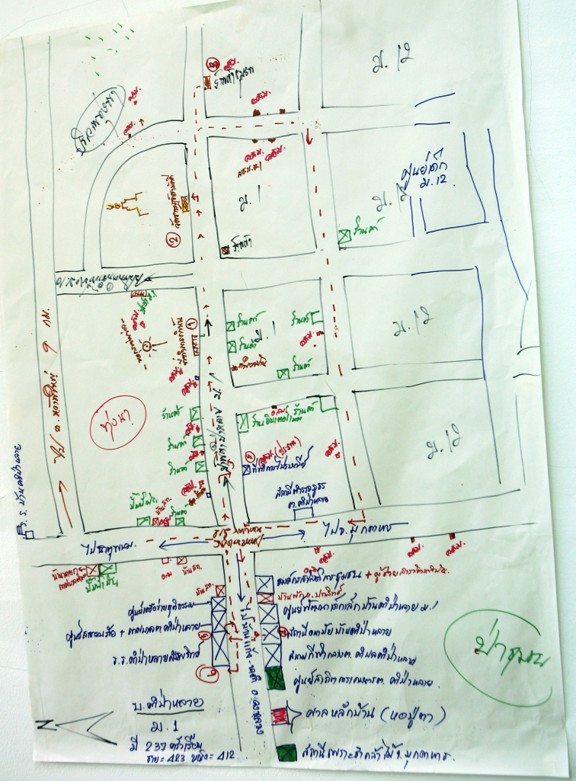
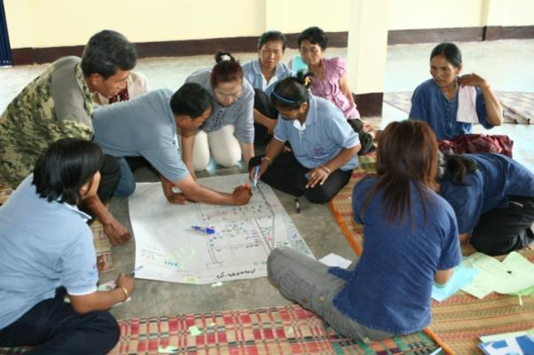
Village Mapping Key Findings
show infrastructure
what is important to them in the village and the surroundings
boundaries of the village with the next village

Slide 45
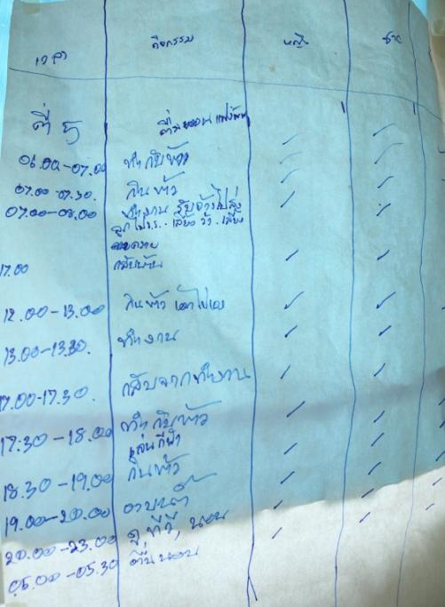
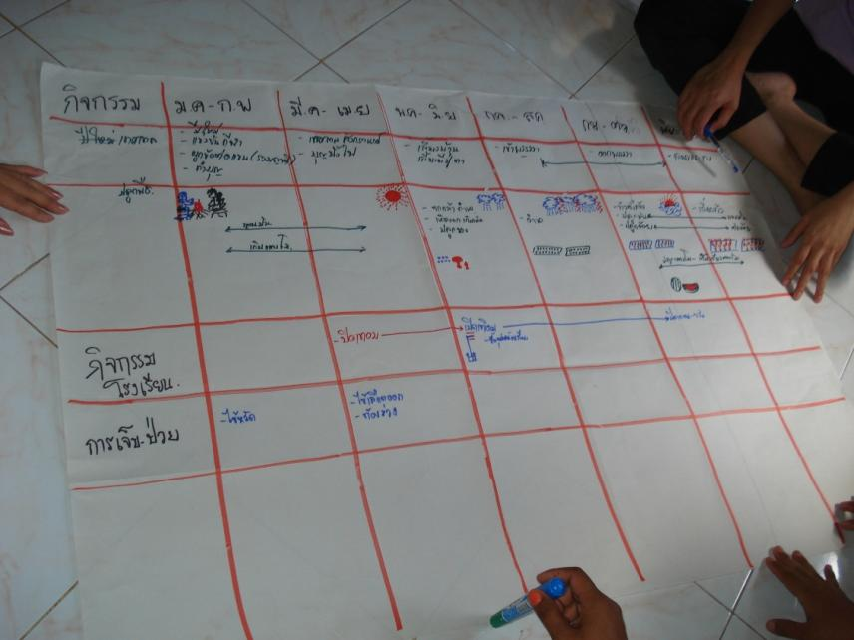
Key Findings
Daily Activities and Seasonal Calendar
Identify village livelihood
Identify periods of greatest difficulty or vulnerability in the community

Slide 46
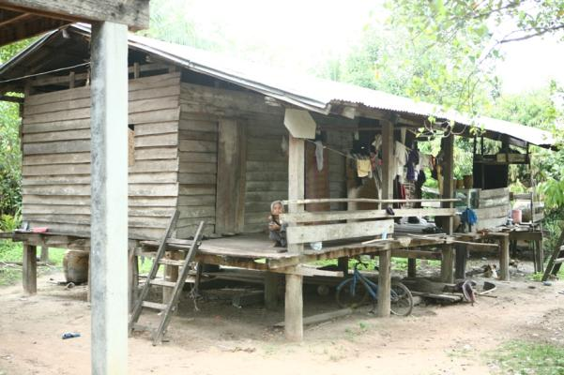
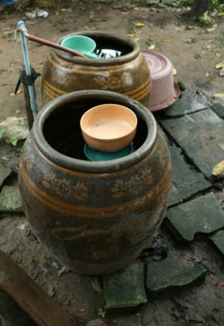
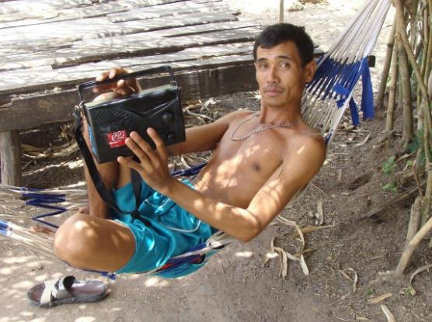
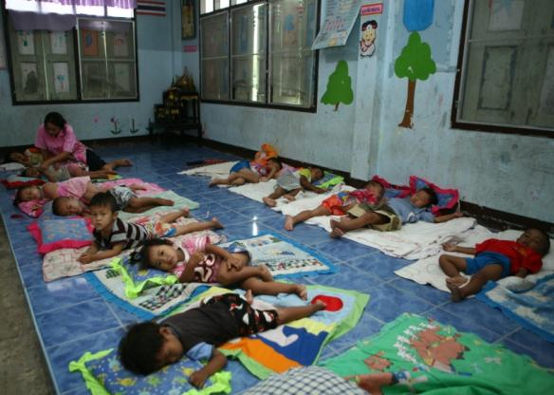
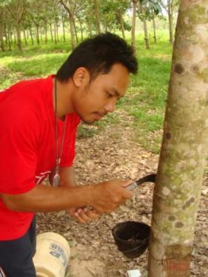
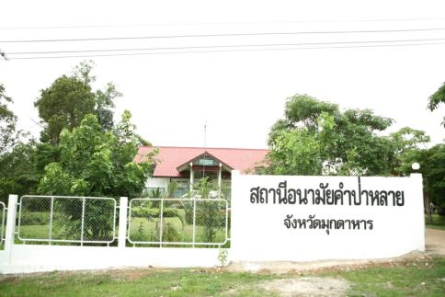
Transect Walk
Observe villagers’ behaviors and available resources in the village which were not included in the map

Slide 47
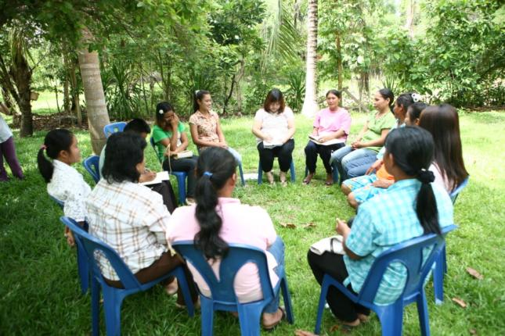
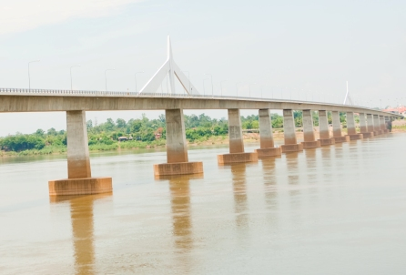
Cross-border Issues
Easier access between Thailand – Laos
Better economy between the two countries
More Lao people visit their relatives or work as field labors in Mukdahan during harvest season
Increased numbers of marriages between Thai and Lao people
Drugs
Gambling & crime
Increased numbers of traffic accident
Increased prices of land in Mukdahan

Slide 48
Key Findings
Issues/ Problem Identifications
Rank/Moo | Moo 1 | Moo 10 | Moo 12 | Moo 16
Men 1st | Unclean water | Dengue fever | Seasonal flu/cold | Water shortage
Women 1st | Garbage | Obesity | Dengue fever | Water shortage
Men 2nd | Dengue fever | Diabetes | Diarrhea | Garbage
Women 2nd | Obesity | Dengue fever | Diarrhea | Garbage
Men 3rd | Chemicals | Peptic ulcer | Dengue fever | Dengue fever
Women 3rd | Seasonal flu/cold | Traffic accident | Seasonal flu/cold | Dengue fever

Slide 49
Cause and Recognition of Symptoms
(Tool: FGD)
Dengue Fever
Mild form | Severe form
Drowsiness Fever Lack of appetite Weak | Prolonged fever Rash Red spots on skin Vomiting Convulsion Coma

Slide 50
Treatment/ Home care: Dengue Fever
If someone in the family has “dengue fever”, they will:
Mild form → observe symptoms → tepid sponge (to cool down body) → give medication to the patients e.g. Paracetamol (bought from grocery shops within their villages) → (in the meantime) use bed nets day and night
Severe form →seek treatment from health center → (if not yet recover) → will go to district hospital (where they take dengue blood test) → if getting worse, be referred to provincial/ regional hospital

Slide 51
Key Findings
Preferred Communication Channels
Rank/Moo | Moo 1 | Moo 10 | Moo 12 | Moo 16
Men 1st | VHVs | VHVs | Health center | Village meeting
Women 1st | Village meeting | Health center | SMS | Village meeting
Men 2nd | Health center | Loud speaker | VHVs | Loud speaker
Women 2nd | Health center | VHVs | Newspaper/ radio | Loud speaker
Men 3rd | Loud speaker | Friends/ neighbors | Village meeting | VHVs
Women 3rd | Loud speaker | Loud speaker | TV/ village meeting | VHVs

Slide 52
Practices to Prevention
Prior outbreak
Clean/remove water from containers that can collect water
Use bed nets, fan and wire door/window during day and night to prevent mosquito bites
Put larvae-eating fish and Temephos in water containers
VHVs conduct home visit to check BI, CI every Friday

Slide 53
Practices to Prevention Key Findings
During outbreak
Report suspected cases to VHVs and/ or local authorities immediately
Spray and fog in and around infected houses
Clean the households and villages’ environment
Put Abate and Salts in water containers
VHVs provide health education to community on practices to prevention and dengue fever control and visit their responsible households to check BI and CI and report results to health center

Slide 54
Impact of diseases issues on individuals and community
Loss of productive time to take care of sick person
Loss of income/absence from work
Fear and worry
Added expenses for treatment and care
Expenditures to buy fuel for spraying and fogging in their households and community

Slide 55
Force Field Analysis
Force Field Analysis
Problem | Cause | Effect | Local resources | Action
Dengue fever | Aedes mosquito | sickness, not good for mental health time and energy to care for sick persons money for treatment and care loss of income | Villagers, VHVs, leaders of village, health officers in health center, local administrative office | destroy mosquito breeding sites using fish for eating larvae Clean environment spray and fogging Cover water containers use bed nets Clean households

Slide 56
Conclusions and Recommendations
Dengue fever was mentioned in all groups among the top three priorities
Other perceived problems included seasonal flu/cold, water shortage, garbage, diabetes, obesity, diarrhea
Preferred communication channels for prevention and control of diseases included community meetings, VHVs, loud speaker, health officials and health center.
VHVs identified as most preferred persons to provide health education and health care to villagers.
Recommend to provide relevant health education and training to VHVs
Need to improve relationship and trust between villagers and health staff
PAR technique and approaches are very useful for health officers in field to hear direct problems/ issues from the community
Timing of this PAR activity may have affected PAR findings and results since most of areas have been infected by Dengue Fever during rainy season

Slide 57
Acknowledgements
Acknowledgements
Dr. Prapas Weerapol, Deputy Provincial Chief Medical Officer, Mukdahan Provincial Health Office
Mr. Thatchai Jaikong, Chief of communicable disease control section, Mukdahan Provincial Health Office
Mr. Krit Phantra, public health officer, Mukdahan Provincial Health Office
Staff at Kam Pa Lai village health center
Local authorities and village health volunteers of the 4 villages (Moo 1, 10, 12 and 16) in Kam Pa Lai, Amphur Muang, Mukdahan province

Slide 58
PAR Chiang Rai

Slide 59
Selection Criteria & Study Sites
Selection criteria: villages nearby Thai-Laos border and/or check-point
Two villages in Rim Khong sub-district, Chiang Khong district, Chiang Rai province:
a) Ban Don Ti (Moo 3)
b) Ban Had Bai (Moo 1)

Slide 60
Village Profile
Description/ Village | Moo. 3 (Ban Don Ti) | Moo. 1 (Ban Had Bai)
Numbers of household | 152 | 139
Numbers of population | 527 | 538
No. males | 248 | 251
No. females | 279 | 287
Numbers of VHVs/ VHV: Household | 15/ 1: 9 | 15/ 1: 10
Race | Thai | Thai Lue (Chinese breed that moved from China, passed through Laos PDR since World War II)
Religion | 95% are Buddhist 5% are Christian | Most of are Buddhist

Slide 61
Village Profile (cont’d)
Description/ Village | Moo. 3 (Ban Don Ti) | Moo. 1 (Ban Had Bai)
Income | Average income per household: 20 – 23K Baht/ year Most of incomes from corn fields twice a year | Hand-made clothes (about 800 – 3,000 Baht per piece) Tobacco, Corns, Nuts
Occupation | Farm/ rice field farmers/ labors (Males -150 – 200 Baht per day while females will get 120 – 150 Baht per day) | Tobacco field famers Yellow nuts farmers Corn field famers
Transportation | Roads within/ pass through whole village are as concrete Public transportations between village and districts (Chiang Khong and Chiang Saen) will be 10 times per day Crossing to Laos by boats – 40 Baht/ round trips | Locate from Chiang Khong district about 35 kilometers Public transportation between village and district is about 4 times a day

Slide 62
Village Profile (Cont’d)
Description/ Village | Moo. 3 (Ban Don Ti) | Moo. 1 (Ban Had Bai)
Resources of food | Plants their own vegetables Get foods and recipes from market 15% of them get food from forest e.g. mushroom, baby bamboo, wild animals, and water weed from Mekong river Having chicken, ducks, fish and forks for family consumption | From fresh market and forest
Other information | Population who have issues on national identification about 111 persons (41 as males and 70 as females) – they are Laotian Rice is producing for household consumption During January – April: water level in Mekong river is always decline | Klong-tum market 2 days weekly Since 2000, market for fresh products every Thursday morning, products are baby bamboo, worms Local products e.g. hand-made clothes
Health related information | Mostly purchase medicines from village’s grocery shops Get health care service from village health center and Chiang Khong and Chiang Saen District hospitals Using “traditional medicine” e.g. herbals within their families Some families get health care service from private clinic at Moo 1

Slide 63
Seasonal Calendar
Outbreaks:
May – December: Influenza
April – June: Diarrhea
May – August: Dengue fever

Slide 64
Cross-border issues
Mostly Thais cross to Laos to visit relatives, and attend festivals and ceremonies
50%: female
35%: male
15%: children
The new bridge is still under construction, which is located about 40 kilometers from the villages - no impact from this bridge was mentioned
2 check points:
Moo 3 check point
Moo 1 check point

Slide 65
Cross-border issues (Cont’d)
Advantages:
More income from Laotians who cross border to buy consumer products in Chiang Rai
Increased number of labors from Laos, esp. in corn farms -150 Baht/ day (female) and 200 Baht/ day (male)
Easy access by boat
Check point at Moo 3 (Ban Don Ti)
Only seeking for treatment at Chiang Khong district hospital
Check point in Moo 1 (Ban Had Bai)
Transportation fee - about 40 Baht/ round trips
Entry fee is 50 Baht per person

Slide 66
Cross-border issues (Cont’d)
Disadvantages:
Drugs (especially in Moo 3)
As more Laotians cross, more outbreaks occur e.g. malaria, dengue fever

Slide 67
Issue/Problem Identification
Male |  | Female
Moo 3 | Moo 1 | Moo 3 | Moo 1
Hypertension Diabetes Liver dysfunction Gout Peptic ulcer Dengue fever H1N1 Influenza | Influenza Hypertension Dengue fever Diabetes Gout Tuberculosis Tonsillitis Arthritis Herniated disk | Obesity Hypertension Diabetes Gout Liver dysfunction Hepatitis Muscle pain Headache Toothache Allergies Anemia Pneumonia Tonsillitis HIV/AIDS Dengue fever Diarrhea Influenza Asthma Cancer | Dengue fever Diabetes Hypertension Cancer Influenza Allergies (from chemical) Anemia

Slide 68
Issue/Problem Identification (Cont’d)
Gender | Male |  | Female
Rank no. / Moo | Moo 3 | Moo 1 | Moo 3 | Moo 1
1st | Hypertension | Influenza | Cancer | Diabetes
2nd | Diabetes | Diabetes | Hypertension/ Obesity/ Diabetes | Hypertension
3rd | Dengue fever | Dengue fever/ Herniated Disk | Peptic ulcer | Allergies (from Chemical)
4th | Gout | Hypertension | Dengue fever | Dengue fever

Slide 69
Cause and recognition of symptoms
Dengue Fever
Influenza
Mild form | Severe form
Fever Fever with chill Headache High body temperature Fatigue Loss of appetite | Bleeding from organs or body Chest pain Difficult to breathe Rash Red spots on skin Vomiting Convulsion
Mild form | Severe form
Low fever Running nose Cough Sneeze Sore throat | Fever High body temperature Difficult to breathe

Slide 70
Care & Treatment
Mild form → (1-2 days) buy medicines from grocery shops in villages, or go to private clinics, or go to village health center, or massagers, or go to ghost doctor: pay only 29 Baht (Moo 1) → (2-4 days, for observation symptoms) → worsen → or go to private clinics, or go to village health center → Chiang Khong District Hospital → go to ghost doctor (in some cases)
Severe form → (immediately) → Chiang Khong District Hospital → Chiang Rai Regional Hospital

Slide 71
Care & Treatment (Cont’d)
Distances:
Grocery shops: 50 meters
Private clinic: 1 kilometer
District hospital: 37 kilometers
** Found more dengue fever cases in adults than in adolescents

Slide 72
Communication channels
Gender | Male |  | Female
Rank no. / Moo | Moo 3 | Moo 1 | Moo 3 | Moo 1
1st | Leaflet | Village health center/ Loud speaker | Community meeting | Village health center
2nd | VHVs/ Loud speaker | VHVs | Loud speaker | VHVs
3rd | Chief village/ TV | Medical doctor | Village health officers | Private clinic/ clinic

Slide 73
Practices to prevention
Dengue Fever:
Use bed net
Use spray or lotion to prevent mosquitoes bites
Destroy mosquito breeding sites and water containers
Special activities –
Campaign by VHVs and village health officers to destroy mosquito breeding sites monthly or every 1 – 2 weeks
Survey of mosquitoes larvae in containers on every Friday
Students to destroy mosquitoes breeding sites and water containers at school

Slide 74
Practices to prevention
Dengue Fever:
If there are sick persons, how to prevent an outbreak –
Use bed net
Absence from school until recover from dengue fever
If needed, hospitalized
Tell neighborhoods and other villagers to destroy mosquito breeding sites and water containers
Clean houses and villages’ environments
Fog by VHVs
Local health administrative office support money for fogging and spraying supplies

Slide 75
Practices to prevention
Influenza:
Use mask
Exercise
Drink a lot of water
Rest
Cover mouth when coughing or sneezing

Slide 76
Force Field Analysis
Force Field Analysis
Problem | Cause | Effect | Local resources | Action
Dengue fever | Aedes mosquito | sickness, not good for mental health waste time and energy to take sick persons spent more money for treatment and health care lack of income | Villagers, VHVs, leaders of village, health officers in health center, local administrative office | destroy mosquito breeding sites put larvae-eating fish in water container clean households and environment spray and fog cover water containers use bed nets

Slide 77
Force Field Analysis
Force Field Analysis
Problem | Cause | Effect | Local resources | Action
Influenza | Weather change Virus Infected from others Unhealthy | transmit to others absence from work Sickness, not good for mental health time and energy to care for sic persons spent more money for care and treatment lack of income | Villagers, VHVs, village leaders , health officers at health center, local administrative office | consume healthy food exercise regularly wash hands often avoid crowded areas

Slide 78
Conclusions
Cross-border issues – claimed outbreaks and health issues from another side of the border
Non-communicable diseases (NCDs) were raised in these villages (reasons? – National health security office promoted searching for new cases of NCDs cases in community)
Diseases in focus of MID-BCC Project were addressed – dengue fever and influenza
Best communication channels for health issues are
VHVs
Health centers
Loud speakers

Slide 79
Community Reflection
Community Reflection: July 9, 2010
PAR approach is great for locals to realize health issues in their communities
Local offices will use findings to develop their action plans for next fiscal year
From this reflection, local health administrative office will support budget and supplies for fogging (dengue fever)
District livestock officials participating at the community reflection gave health education on anthrax and relevant zoonotic diseases

Slide 80
Acknowledgements
BVBD, MOPH
Chiang Rai Provincial Health Office
Chiang Khong Health Office
Chiang Khong District Hospital
District Livestock office, Chiang Khong District
Mukdahan Provincial Health Office

Slide 81
Formative Research
Rapid Appraisal
Participatory Action Research
Robert Kelly, Ph.D.
Prepared by AED

